Slide 1
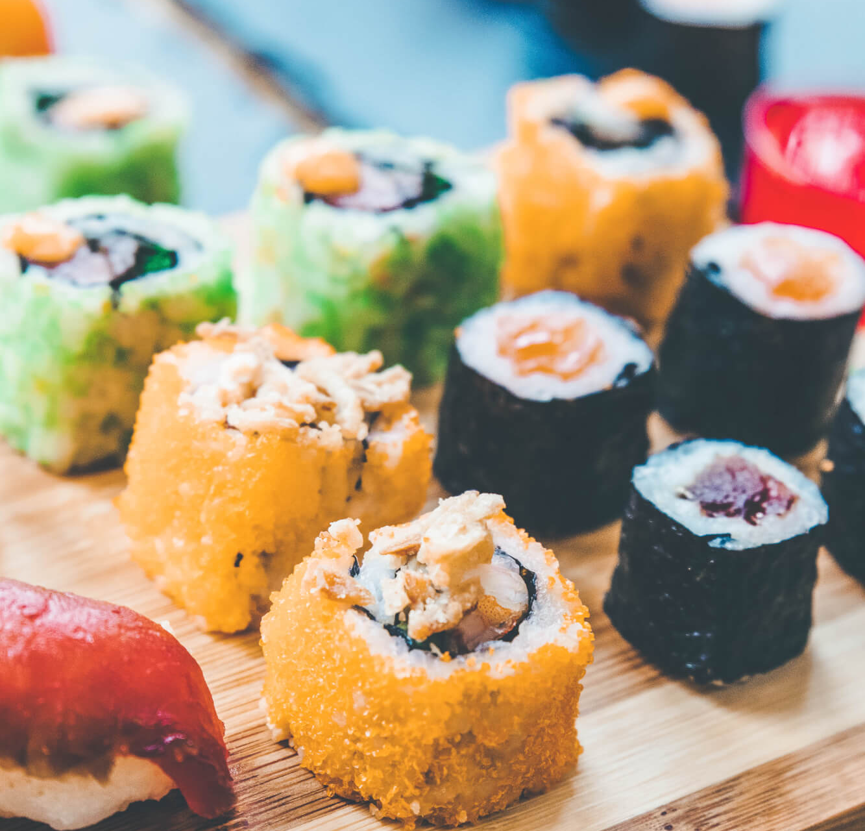
Danny's Diner Customer Insights Using SQL to Enhance Customer Experience
Presented by: Ravi Kumar Yadav

Slide 2
Introduction
Content:
Danny loves Japanese food and opened Danny’s Diner in 2021.
Sells sushi, curry, and ramen.
Needs help analyzing customer data to improve business operations.
Aim: Understand customer spending patterns, preferences, and loyalty program impact.

Slide 3
Problem Statement
Content:
Danny wants insights into customer behaviour.
Key Questions:
Visiting patterns
Total spend
Favourite menu items
Use insights to expand the customer loyalty program.

Slide 4
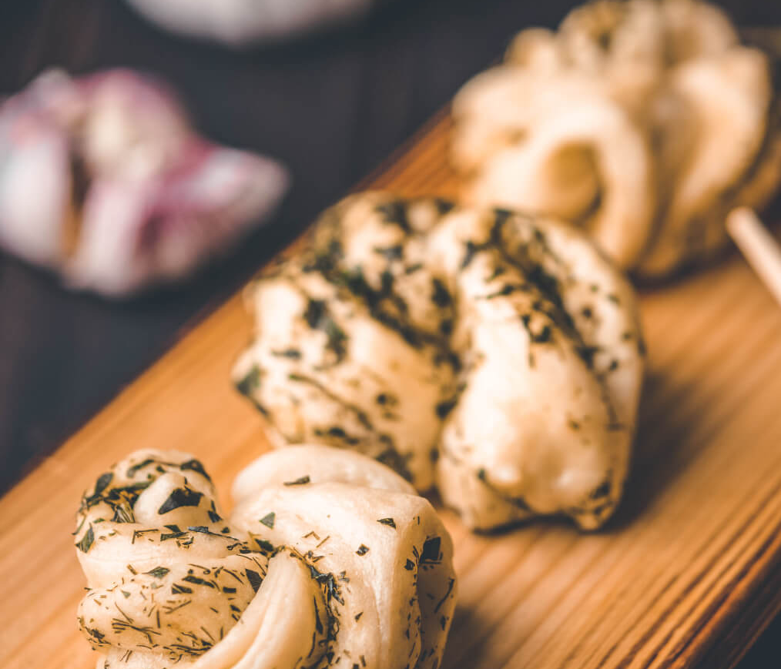
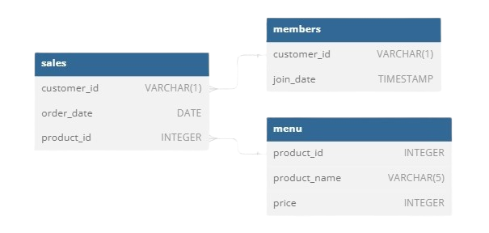
Schema

Slide 5
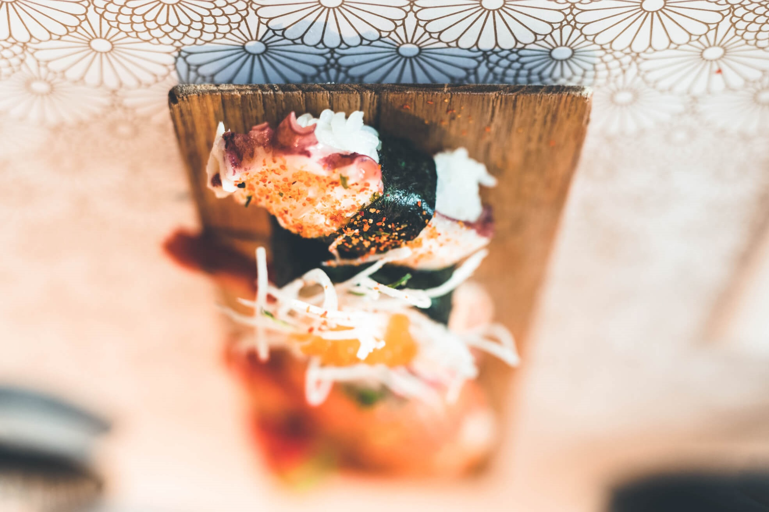

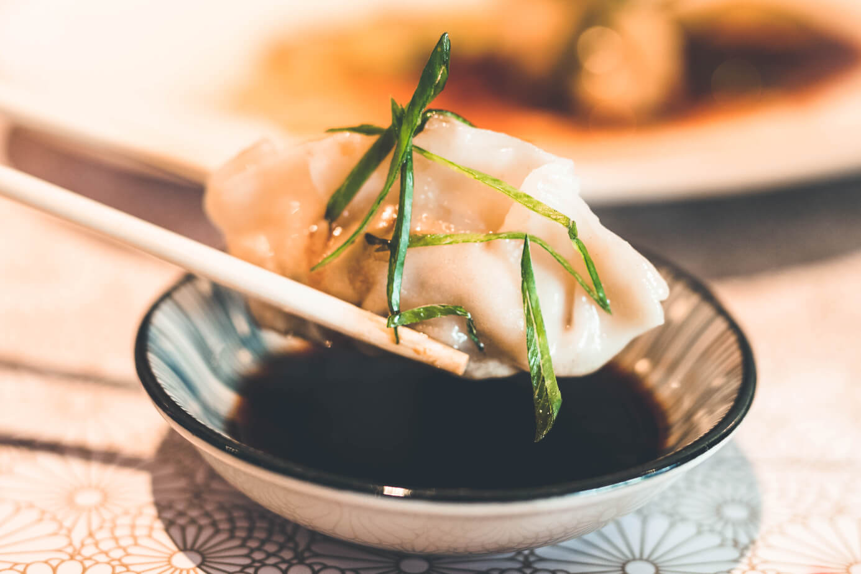
1. Total Amount Spent by Each Customer
SELECT customer_id,
SUM(menu.price) AS total_expense
FROM sales s , menu
WHERE s.product_id = menu.product_id
GROUP BY 1;

Slide 6

2. Days Each Customer Visited the Restaurant
SELECT customer_id,
COUNT(DISTINCT(order_date)) AS days_visited
FROM sales
GROUP BY 1;

Slide 7

3. First Item Purchased by Each Customer
SELECT DISTINCT
customer_id,
FIRST_VALUE(product_name) OVER(PARTITION BY customer_id ORDER BY order_date) AS first_order
FROM sales s, menu m
WHERE s.product_id = m.product_id;

Slide 8

4. Most Purchased Item on the Menu
SELECT product_name,
COUNT(s.product_id) AS popularity
FROM sales s, menu m
WHERE s.product_id = m.product_id
GROUP BY 1
ORDER BY 2 DESC
LIMIT 1;

Slide 9
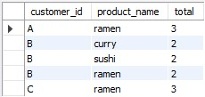
5. Most Popular Item for Each Customer
WITH CTE AS
(
SELECT
customer_id, product_name,
COUNT(*) AS total,
RANK()OVER(PARTITION BY customer_id ORDER BY COUNT(*) DESC ) AS RN
FROM sales s, menu m
WHERE s.product_id = m.product_id
GROUP BY 1,2
)
SELECT customer_id, product_name, total
FROM CTE
WHERE RN = 1
GROUP BY 1,2;

Slide 10

6. First Item Purchased After Becoming a Member
WITH CTE AS
(
SELECT s.customer_id,
m.product_name,
order_date,join_date,
RANK()OVER(PARTITION BY s.customer_id ORDER BY order_date) AS RN
FROM sales s
JOIN menu m
ON s.product_id = m.product_id
JOIN members mem
ON s.customer_id = mem.customer_id
WHERE order_date >= join_date
ORDER BY s.customer_id,order_date
)
SELECT customer_id, product_name, order_date, join_date FROM CTE
WHERE RN = 1;

Slide 11

7. Item Purchased Just Before Becoming a Member
WITH CTE AS
(
SELECT s.customer_id,
m.product_name,
order_date, join_date,
RANK()OVER(PARTITION BY s.customer_id ORDER BY order_date DESC) AS RN
FROM sales s
JOIN menu m
ON s.product_id = m.product_id
JOIN members mem
ON s.customer_id = mem.customer_id
WHERE order_date < join_date
ORDER BY s.customer_id,order_date
)
SELECT customer_id, product_name, order_date, join_date
FROM CTE
WHERE RN = 1;

Slide 12

8. Total Items and Amount Spent Before Becoming a Member
SELECT s.customer_id,
COUNT(m.product_id) AS total_items ,
SUM(price) AS amount_spent
FROM sales s
JOIN menu m
ON s.product_id = m.product_id
JOIN members mem
ON s.customer_id = mem.customer_id
WHERE order_date < join_date
GROUP BY 1
ORDER BY s.customer_id;

Slide 13

9. Total Points for Each Customer, when each $1 spent equates to 10 points and sushi has a 2x points multiplier.
WITH CTE AS
(
SELECT customer_id, product_name, price, price*IF(product_name = 'sushi',2,1) AS points_multiplier
FROM sales s
JOIN menu m
ON s.product_id = m.product_id
)
SELECT customer_id,
SUM(points_multiplier) AS total_points
FROM CTE
GROUP BY customer_id;

Slide 14

10. Points for Customer A and B at the End of January, In the first week after a customer joins the program (including their join date) they earn 2x points on all items, not just sushi - how many points do customer A and B have at the end of January?
WITH CTE AS
(
SELECT s.customer_id, s.order_date, m.product_name, m.price,
CASE
WHEN order_date BETWEEN mem.join_date AND DATE_ADD(mem.join_date,INTERVAL 6 DAY) THEN m.price * 2 WHEN order_date NOT BETWEEN mem.join_date AND DATE_ADD(mem.join_date,INTERVAL 6 DAY) AND product_name = 'sushi’ THEN m.price * 2
ELSE price*1
END AS total_points
FROM sales s
JOIN menu m
ON s.product_id = m.product_id
JOIN members mem
ON mem.customer_id = s.customer_id
WHERE order_date < '2021-01-31’
ORDER BY order_date
)
SELECT customer_id, SUM(total_points) AS total_points_till_Jan_31
FROM CTE
GROUP BY customer_id
ORDER BY customer_id;

Slide 15
Conclusion
Customer with ID B visited the restaurant maximum number of times.
Ramen is the most popular dish among the customer's.
Common dish that each customer had before signing up for membership was Sushi.
Customer with ID B has the most points before getting the membership among all the customer’s.
Till the end of month January customer with ID A has more points amongst the members.
Total expenditure by all customer’s was 186$.

Slide 16
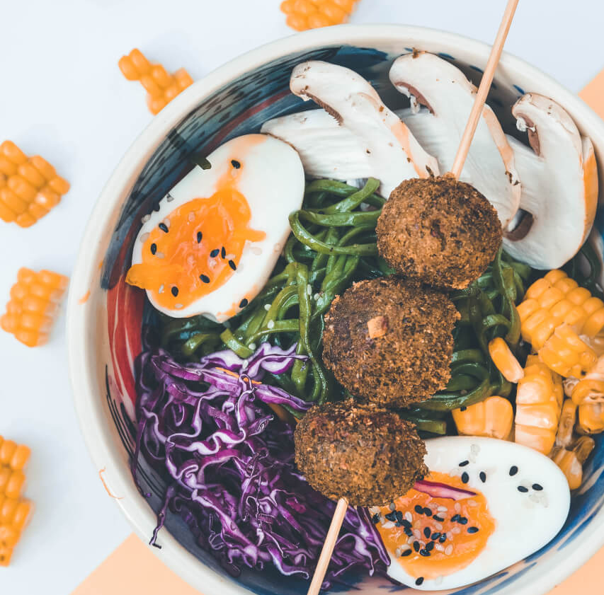
THANKS
Do you have any questions?
rago25.ds@gmail.com
+91 7678362012
LinkedIN

